Slide 1


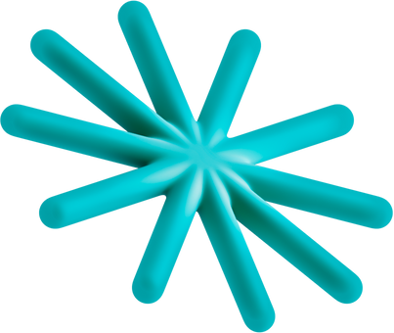
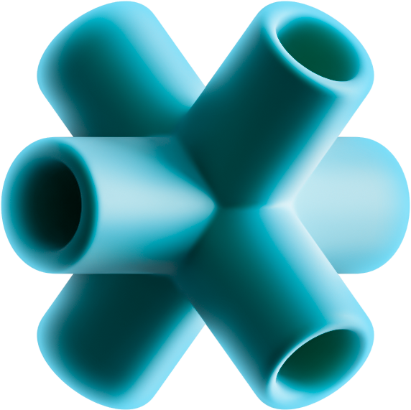
AI-ASSISTED COMPUTER AIDED DESIGN OF MECHANICAL PARTS
PRESENTED BY:
Tala Ibraheem
Joud Bani-Issa
Tala Hashem

Slide 2


Table of Contents
Project Overview
Dataset Acquisition
Large Language Models
Dataset Creation
Training
Results and Comparison
Creating JSON
CadQuery Conversion
Demo

Slide 3




Project Overview
Dataset
pre-trained model
JSON
CadQuery Code
generate_file()
output of fine-tuned model
json to CadQuery conversion
User prompt
Fine-tuned model
filling the json

Slide 4

Dataset Acquisition

Slide 5



Exploring 3D Datasets
File Type
Models and Shapes
Selected for use
stl, step,
obj, png
Mechanical Parts, architectural components
NO
stl, obj,
ply
Furniture, vehicles, household items, electronics, animals
NO
stl, step,
obj, png, json
Mechanical components
YES

Slide 6
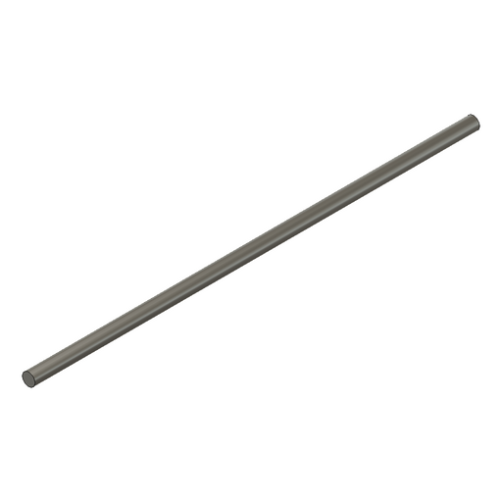
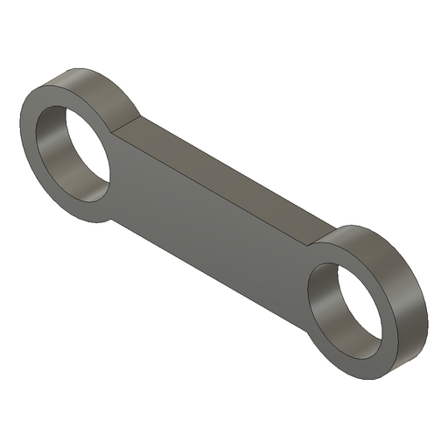
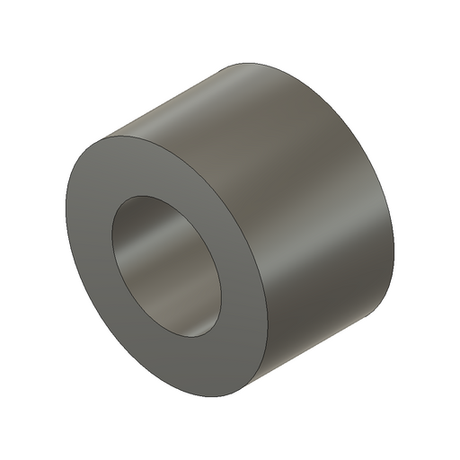
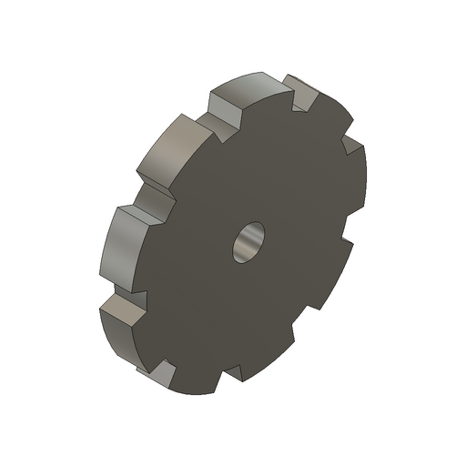
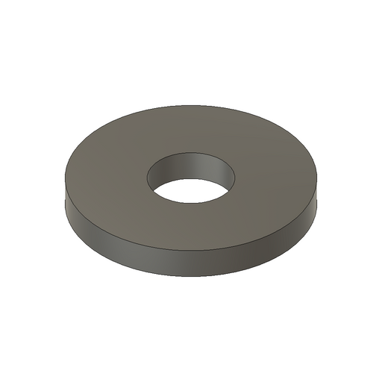
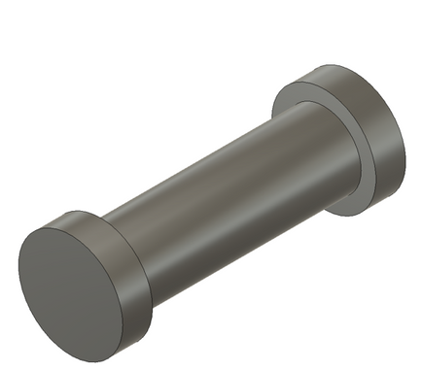
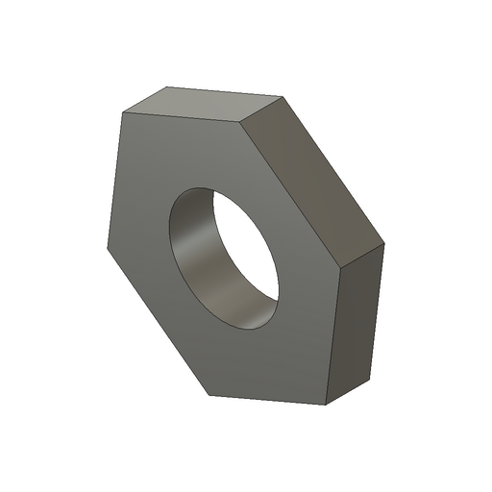
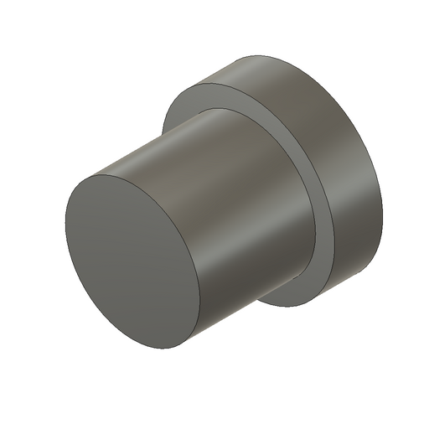
Fusion 360 Dataset Samples

Slide 7
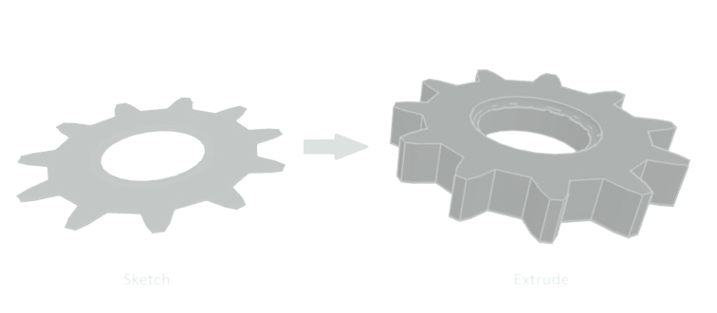
JSON Files
Human readable text to store data.
Contain instructions on how to construct the models using sketch and extrude operations.
Document essential attributes such as point coordinates and key dimensions.
Sketch Extrude

Slide 8

Refine the JSON
Replace random ID’s to more meaningful ones
Standardize the center point across all files to the origin
Analyze the JSON to comprehend the computation process for each value

Slide 9

What is our goal?
User Prompt
JSON file

Slide 10


What is the mystery box?!
Function(Generate_file) to fill JSON pre-defined templates.
Specific arguments are needed for the filling.
Language Model (LLM) extracts and calculates values
from prompts.
LLM generates a function call with the required values.
Executing calls creates structured JSON
Equations based on extracted info define shape points and
characteristics.

Slide 11

CadQuery Conversion
CadQuery is a Python library for parametric 3D modeling, offering a scripting interface for easy design automation.
JSON to CadQuery conversion.
Utilize CadQuery's Python library.
Map JSON structure to CadQuery methods.
Add user comments for clarity.
Include STL and SVG export options.

Slide 12
Snippet of JSON | Cadquery
# parameters
origin = (0.0,0.0,0.0)
radius =8.89
# creating circle
outer_circle = (cq. Workplane("XY"). circle(radius). translate(center_point))
"entities": {
"entity1":{
"points":{
"origin":{
"type": "Point3D",
"x": 0.0,
"y": 0.0,
" z": 0.0
},…}
"outer_circle": {
"type": "SketchCircle",
… ,
"center_point": "point1",
"radius": 8.89
},...

Slide 13

Our proposed system:
Dataset
pre-trained model
JSON
CadQuery Code
generate_file()
output of fine-tuned model
json to CadQuery conversion
User prompt
Fine-tuned model
filling the json

Slide 14

Large Language Models
LLMs are advanced deep learning models
Recognize and generate text, among other tasks
Trained on huge sets of data — hence the name "large."
The models we used for this study are:
Llama2- 7b
Falcon- 7b
Mistral- 7b

Slide 15
Fine-tuning LLMs
Customizing pre-trained language models to cater to specific tasks or domains.
Fine-tuning requires minimal data, making it ideal for tasks with limited or specialized datasets.
It is computationally less expensive than training models from scratch, providing efficient customization without high costs.
Dataset
pre-trained model
fine-tuned model

Slide 16
SHAPES CHOSEN

Slide 17
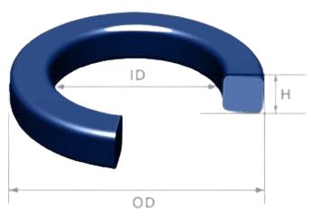
Flat O-Rings
Mechanical flat O-rings are characterized by a smooth, flat profile, featuring an inner radius, outer radius, and thickness.
Critical Geometric Parameters:
Area of inner circle
Area of two concentric circles
Perimeter of inner and outer circles
Thickness

Slide 18
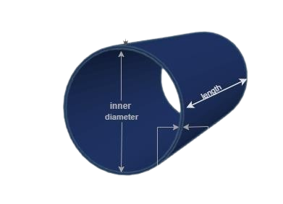
Tubes
Cylindrical structures with inner and outer radius, along with a defined length and wall thickness.
Critical Geometric Parameters:
Area of inner circle
Area of two concentric circles
Perimeter of inner and outer circles
Tube length
Wall thickness

Slide 19
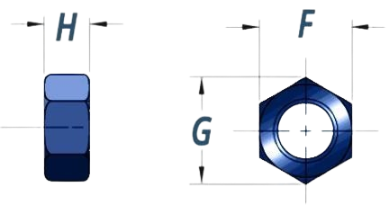
Hexagon Nuts
Hexagon nuts, or hex nuts, feature a width across flats, width across corners, and an inner circle diameter, determining their compatibility with bolts or screws for secure fastening in diverse applications.
Start and end points of each side of the hex
Area of the hexagon
Area of the inner circle
Annular area: the difference area between
the hexagon and circle
Perimeter of inner circles
Thickness

Slide 20
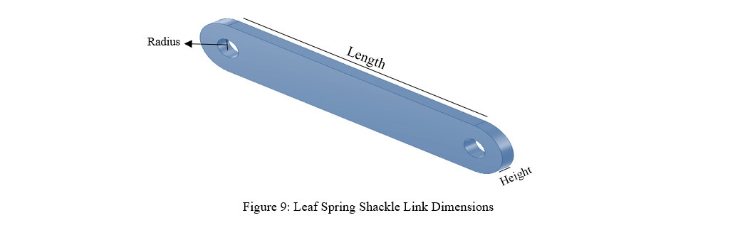
Leaf Spring Shackle Link
Leaf spring suspension systems commonly used in vehicles such as trucks, trailers, and some SUVs. They are crucial for allowing the leaf springs to flex and absorb shocks while the vehicle is in motion.
Critical Geometric Parameters:
Leaf spring length
Joint radius
Thickness
Profile area
Profile perimeter

Slide 21
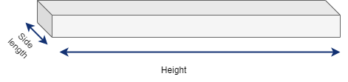
Mild Square Bar
Mild square bar refers to square-shaped bars made from mild steel. Mild square bars, commonly made from mild steel, serve essential functions across various industries.
Critical Geometric Parameters:
Side length
Height
Profile area
Profile perimeter

Slide 22
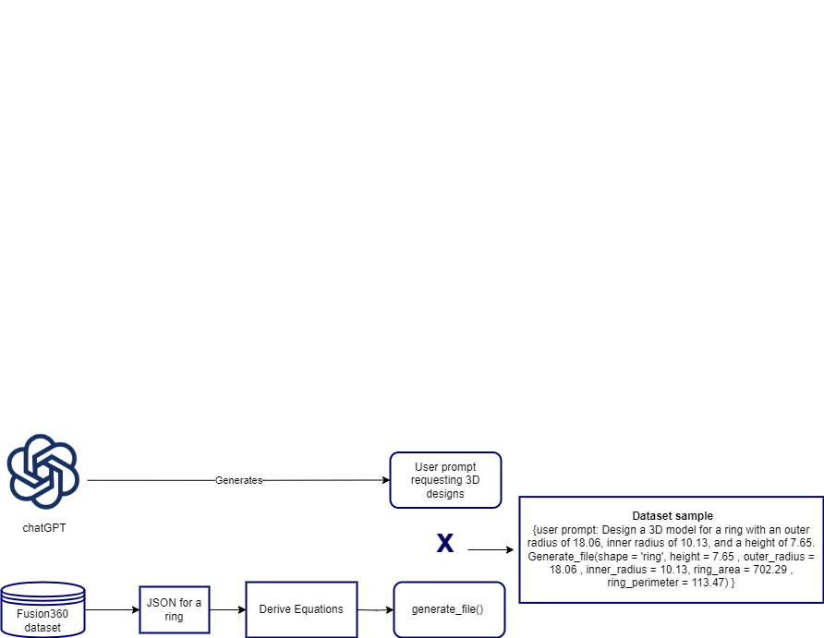
Dataset Creation

Slide 23
Dataset Creation
Extracted Values:
height = 7.65
outer_radius=18.06
inner_radius=10.13
ring_area=702.29
ring_perimeter=113.47
Generate_file(shape=’ring’ ,height = 7.65,outer_radius =18.06 , inner_radius =10.13,ring_area = 702.29 .ring_perimeter = 113.47)

Slide 24
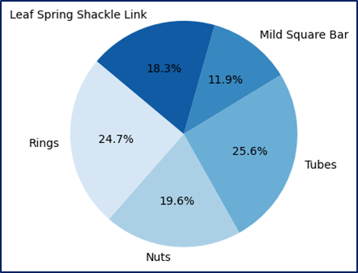
Dataset Size

Slide 25

Our proposed system:
Dataset
pre-trained model
JSON
CadQuery Code
generate_file()
output of fine-tuned model
json to CadQuery conversion
User prompt
Fine-tuned model
filling the json

Slide 26
Large Language Model Architecture

Slide 27
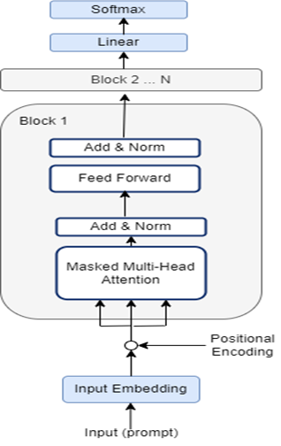
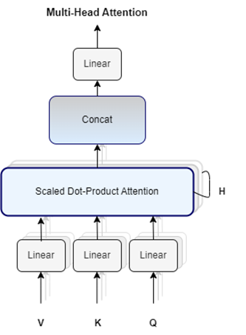
Attention Block

Slide 28
Preparing the Trainer
Tokenizer
Quantization
LoRa Configuration
Load Dataset

Slide 29
Tokenizer
Converts human language into a format that LLMs can process and understand.
Each model has its tokenizer designed for its architecture.
PROMPT: Generate a ring
LLM
Auto Tokenizer
165
30
30
TOKEN IDs
Generate
a
ring

Slide 30


Load and Quantize the model
HuggingFace: An open-source platform providing a variety of LLMs.
To use a model, we need to load its weights and parameters, which requires an immense amount of memory.
Load 7b Parameters
This requires an extensive amount of memory.

Slide 31
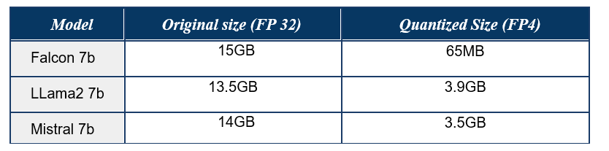
Quantization
Quantization involves converting the model's parameters and weights from their original 32-bit format to lower precision alternatives, such as:
16-bit floating point
8-bit integer
4-bit integer

Slide 32
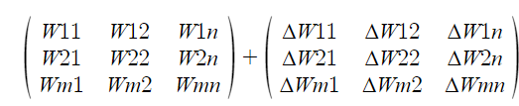
LoRa Configuration
Unlike full model fine-tuning, which is resource-intensive in terms of time and computational costs, LoRa:
Introduces a limited set of trainable parameters.
Keeps the original model parameters unchanged and frozen.
Model Weights
K,Q,V Weights
Still Same size of weights

Slide 33
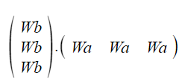
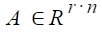
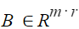
LoRa Configuration
ΔW=
= B.A
Matrix Decomposition
Trainable Parameters

Slide 34
The Trainer
Tokenizer
Trainer
LLM from HuggingFace
Quantized LLM
Peft Lora Config
w = A.B
Train/Eval datasets

Slide 35
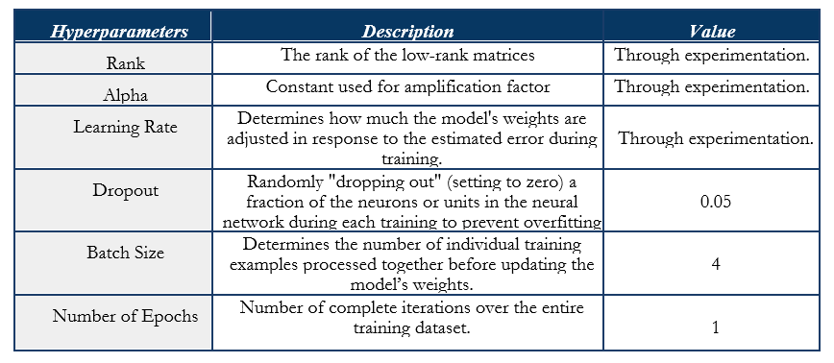
Hyperparameters

Slide 36
Model Comparison and Results

Slide 37
Evaluation Metrics
For evaluation, we used different metrics:
Loss Function
Bleu score
Text similarity
Accuracy percentage
Time for evaluation

Slide 38
LOSS FUNCTION
During backpropagation, the loss computed involves:
Updating the model’s weights.
Minimizing the difference between the probability of the
actual text and the probability of the predicted text.

Slide 39
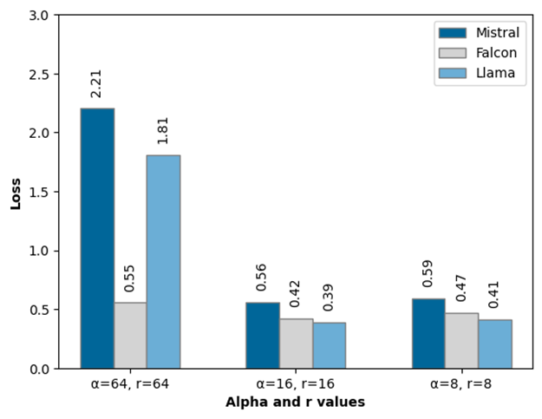
Adjusting alpha and r based on loss function

Slide 40
Bleu Score
It measures how well the generated text captures the vocabulary
of the reference text.
Measures the number of words that were predicted by the
model and present in the actual output (however it
doesn’t take the order into consideration).

Slide 41
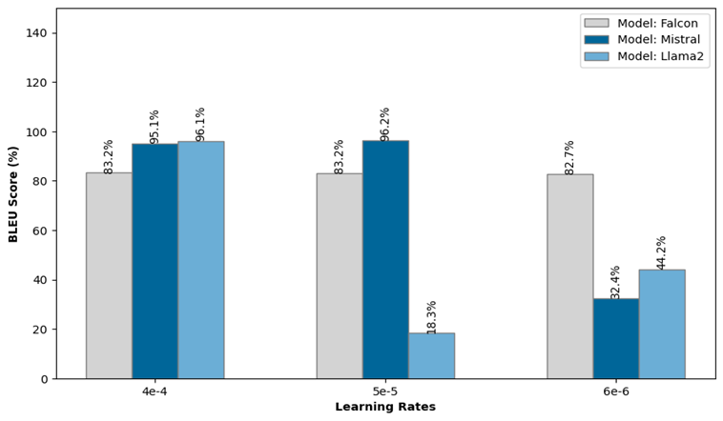
Adjusting The Learning Rate based on Bleu Score

Slide 42
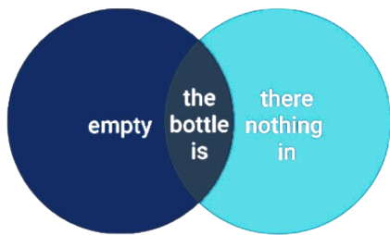
Similarity Text
Compares text outputs by highlighting common and unique elements.
Converts predicted and actual word lists into sets to remove duplicates.
Finds the intersection of the sets to identify common words.
Finds the union of the sets to identify all unique words.

Slide 43
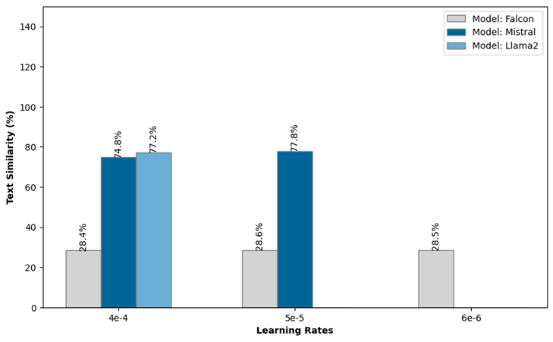
Adjusting The Learning Rate Based on Similarity Text

Slide 44
Accuracy Percentage
Represents the proportion of correct predictions made by a forecasting model.
Calculated as the difference between 100 and the Mean Absolute Percentage Error (MAPE).
Provides an intuitive sense of the model’s accuracy.
Expressed as a percentage, where higher values indicate better model performance.

Slide 45
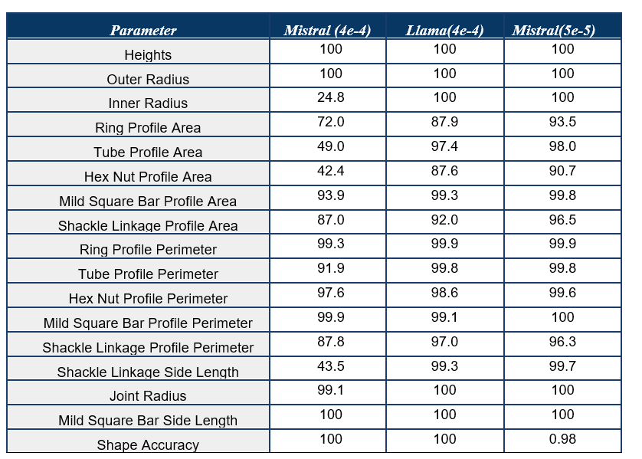
Comparison based on accuracy

Slide 46
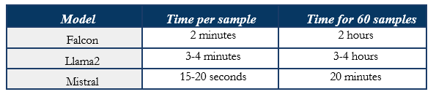
Time Taken by Each Model During Evaluation

Slide 47
Our proposed system
Dataset
pre-trained model
JSON
CadQuery Code
generate_file()
output of fine-tuned model
json to CadQuery conversion
User prompt
Fine-tuned model
filling the json

Slide 48
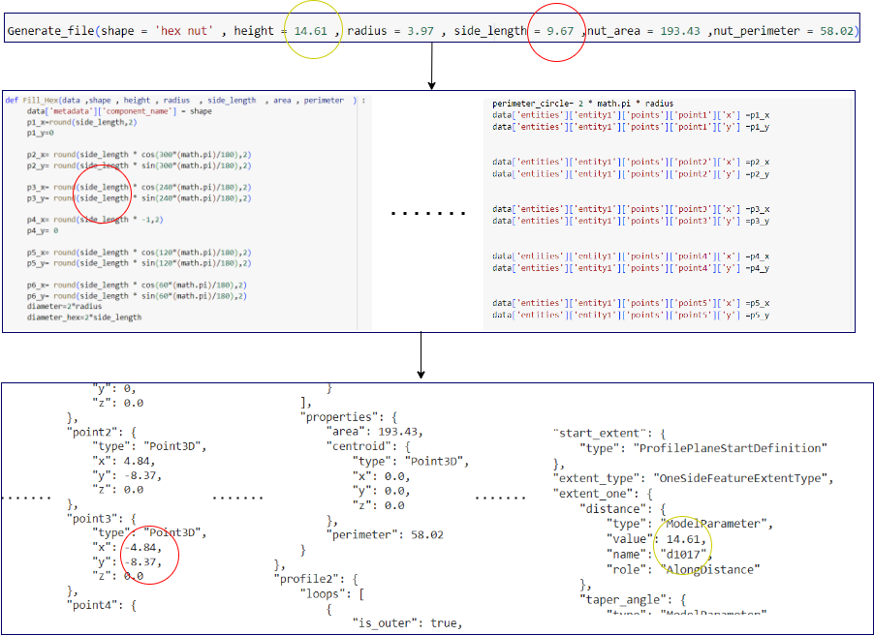
CADquery Code

Slide 49
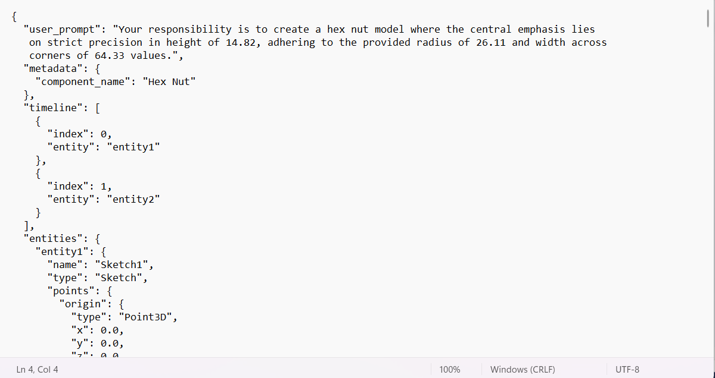
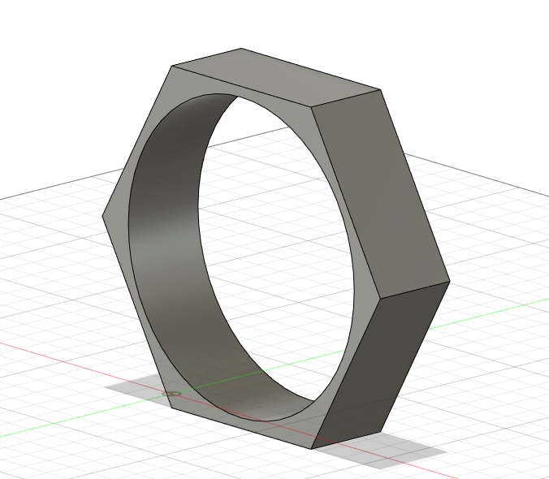

Slide 50



Convert to CadQuery
Dataset
pre-trained model
Conversion
User prompt
Fine-tuned model
JSON
CADquery Code

Slide 51
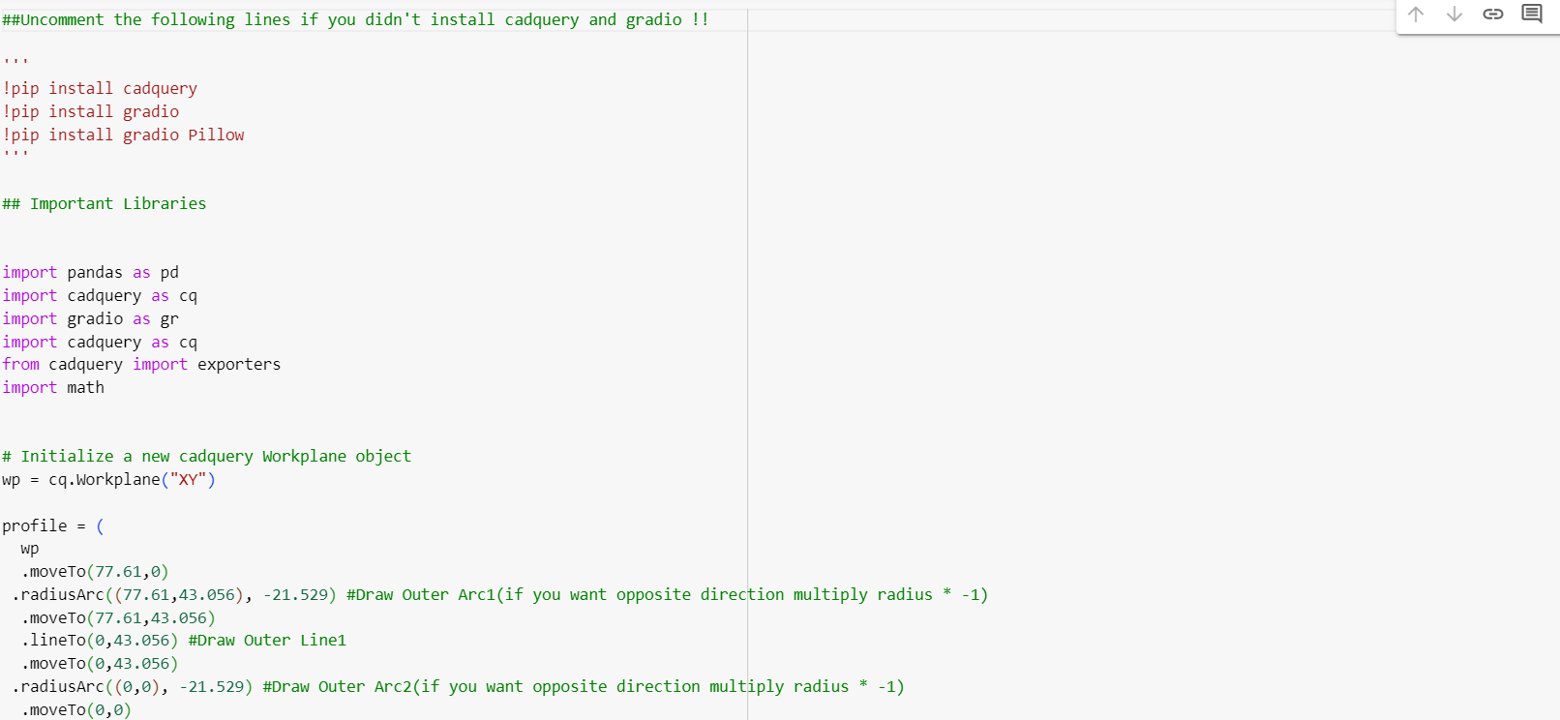

Slide 52
Options Available
Insert the parameters into the JSON
Convert to CadQuery
Export into STL file
Use Fusion 360 GYM and edit your model
Import CadQuery Library and edit your model using python
Model is ready for 3D printing
Option 1
Option 2
Option 3

Slide 53

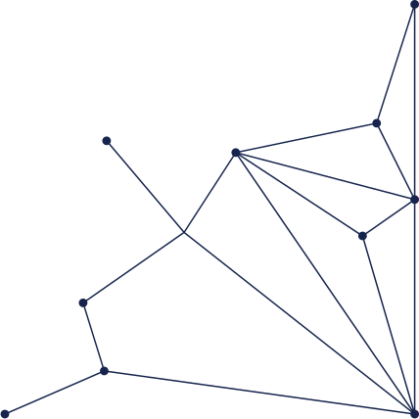

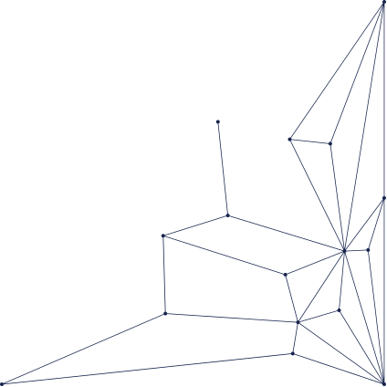
Demo
link

Slide 54
THANK YOU

